Slide 1
Algorithm Development and Control Statements: Part 1
Chapter 4 of C++ How to Program, 10/e

Slide 2
4.1 Introduction
Before writing a program to solve a problem, have a thorough understanding of the problem and a carefully planned approach to solving it.
Understand the available building blocks and employ proven program-construction techniques.

Slide 3
4.2 Algorithms
Any solvable computing problem can be solved by the execution a series of actions in a specific order.
An algorithm is a procedure for solving a problem in terms of
the actions to execute and
the order in which these actions execute
Specifying the order in which statements (actions) execute in a computer program is called program control.
This chapter investigates program control using C++’s control statements.

Slide 4
4.3 Pseudocode
Pseudocode (or “fake” code) is an artificial and informal language that helps you develop algorithms.
Similar to everyday English
Helps you “think out” a program before attempting to write it.
Carefully prepared pseudocode can easily be converted to structured portions of C++ programs.
Normally describes only executable statements.
Declarations (that do not have initializers or do not involve constructor calls) are not executable statements.
Fig. 4.1 corresponds to the algorithm that inputs two integers from the user, adds these integers and displays their sum.

Slide 5
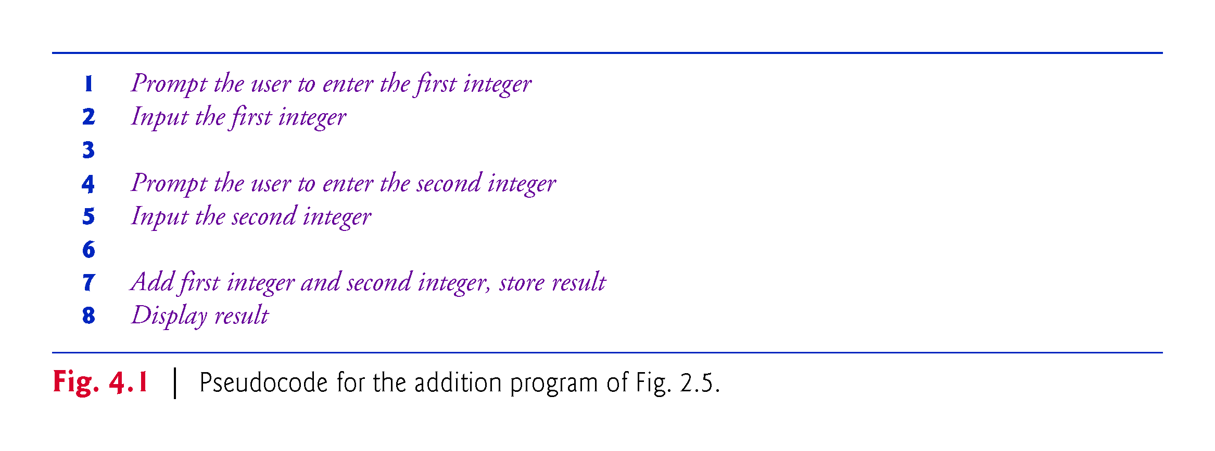

Slide 6
4.4 Control Structures
Normally, statements in a program are executed one after the other in the order in which they’re written.
Called sequential execution.
Various C++ statements enable you to specify that the next statement to execute may be other than the next one in sequence.
Called transfer of control.
All programs could be written in terms of only three control structures
the sequence structure
the selection structure and
the iteration structure
When we introduce C++’s implementations of control structures, we’ll refer to them in the terminology of the C++ standard document as “control statements.”

Slide 7
4.4.1 Sequence Structure
Unless directed otherwise, the computer executes C++ statements one after the other in the order in which they’re written—that is, in sequence.
The Unified Modeling Language (UML) activity diagram of Fig. 4.2 illustrates a typical sequence structure in which two calculations are performed in order.

Slide 8
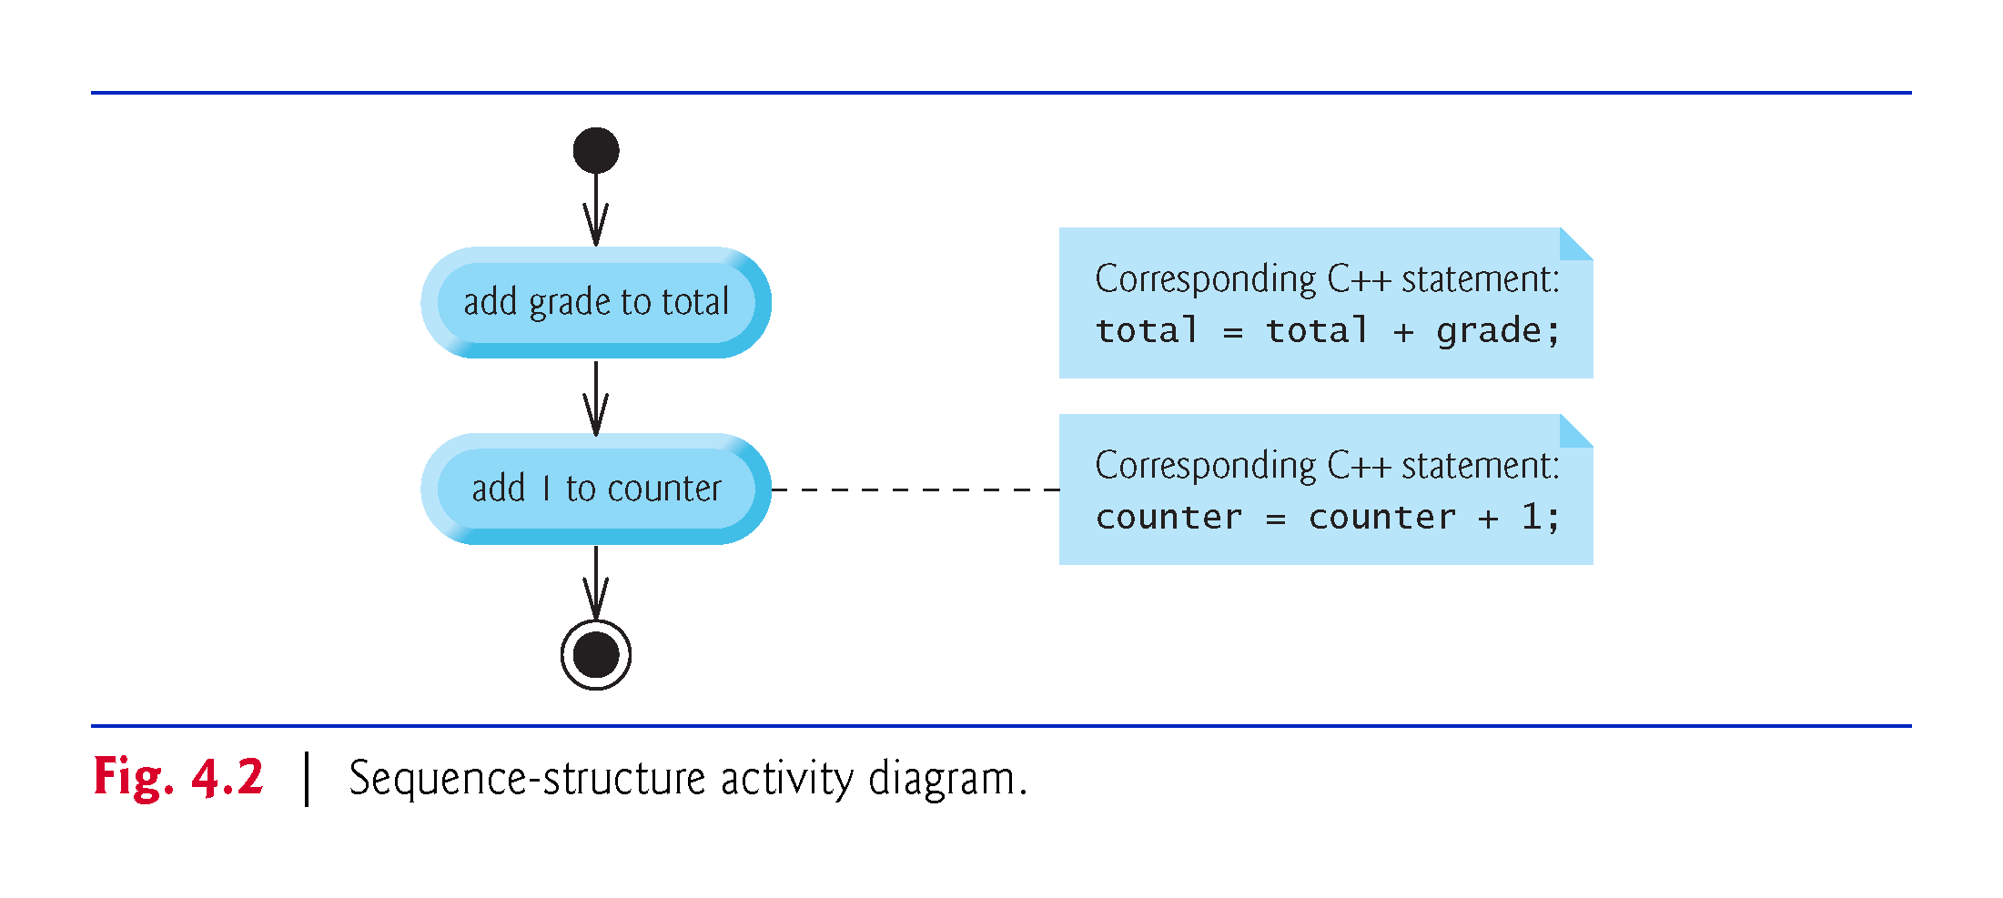

Slide 9
4.4.1 Sequence Structure
An activity diagram models the workflow (also called the activity) of a portion of a software system.
Activity diagrams are composed of special-purpose symbols, such as
Action state symbols (rectangles with their left and right sides replaced with arcs curving outward). They represent actions to perform.
Diamonds. They represent decisions.
Small circles. They represent the initial and final states.
Transition arrows. They represent the flow of the activity.
In addition, there are often
Rectangles with the upper-right corners folded over. They are used for explaining action state symbols.

Slide 10
4.4.2 Selection Statements
C++ has three types of selection statements (discussed in this chapter and Chapter 5).
The if selection statement either performs (selects) an action (or group of actions) if a condition (predicate) is true or skips the action (or group of actions) if the condition is false.
The if…else selection statement performs an action (or group of actions) if a condition is true or performs a different action (or group of actions) if the condition is false.
The switch selection statement (Chapter 5) performs one of many different actions (or groups of actions), depending on the value of an integer expression.

Slide 11
4.4.2 Selection Statements
Syntax for if statements:
if (condition)
action;
Or if there are several actions,(or only one but for clarity):
if (condition)
{ action1;
action1;
}

Slide 12
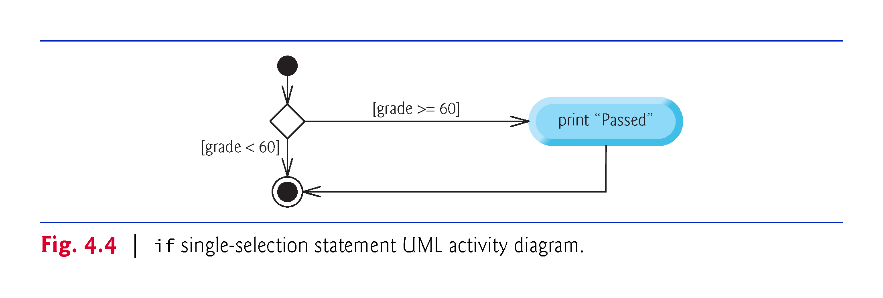

Slide 13
4.4.2 Selection Statements
Syntax for if—else statements:
if (condition)
action1;
else
action2;
Or as before, if there are several actions, or for clarity:
if (condition)
action1;
else
{
action2;
action2;
}

Slide 14
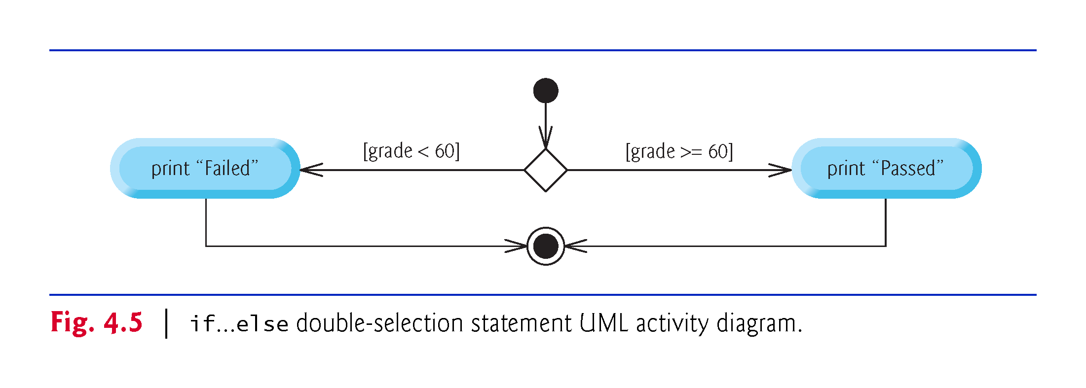

Slide 15
4.4.2 Selection Statements
Write a program in which the user enters a number grade and it returns “Pass” if the grade is 60 or more and “Fail” if the grade is less than 60.
Modify the program so that it returns the letter grade corresponding to the number grade:
F if the number grade is less than 60.
D if the number grade is between 60 and 69, both inclusive.
C if the number grade is between 70 and 79, both inclusive.
B if the number grade is between 80 and 89, both inclusive.
A if the number grade is between 90 and 100, both inclusive.

Slide 16
4.4.3 Iteration Statements
C++ provides three types of iteration statements (also called looping statements or loops) for performing statements repeatedly while a condition (called the loop-continuation condition) remains true—while, do…while and for.
The while and for statements perform the action (or group of actions) in their bodies zero or more times.
The do…while statement performs the action (or group of actions) in its body at least once.

Slide 17
4.4.3 Iteration Statements
Each of the words if, else, switch, while, do and for is a C++ keyword.
These words are reserved by the C++ programming language to implement various features, such as C++’s control statements.
Keywords cannot be used as identifiers, such as variable names.
Figure 4.3 provides a complete list of C++ keywords-.

Slide 18
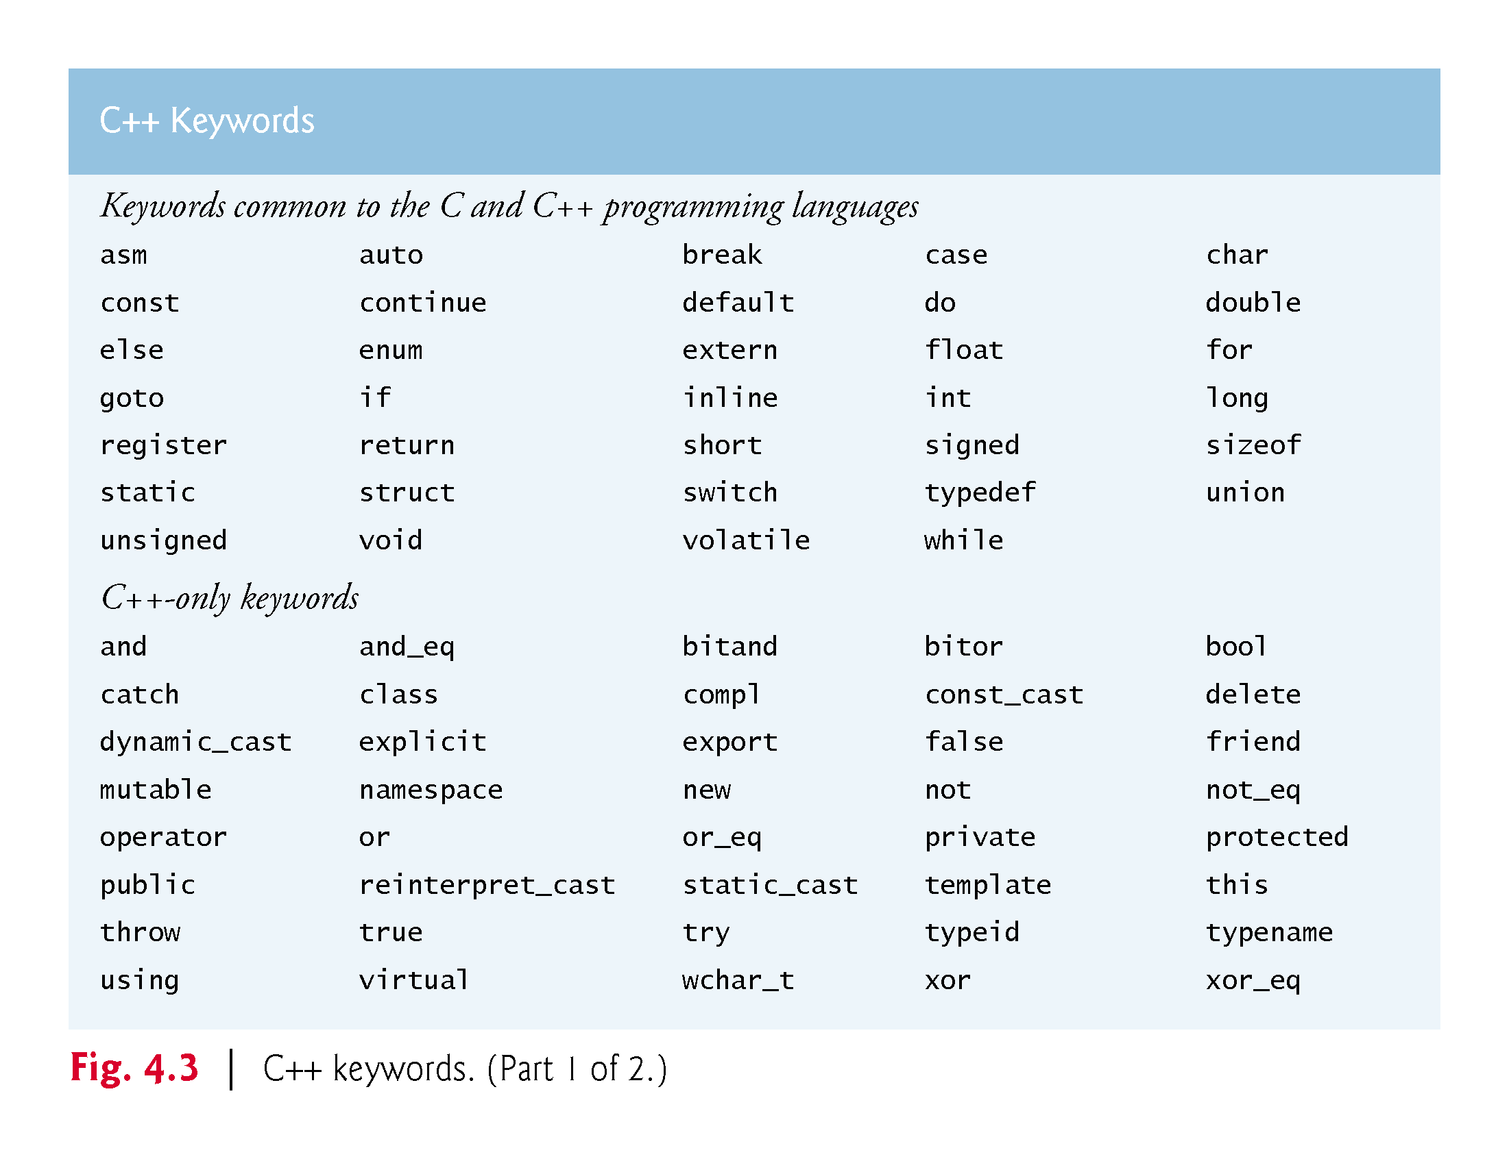

Slide 19
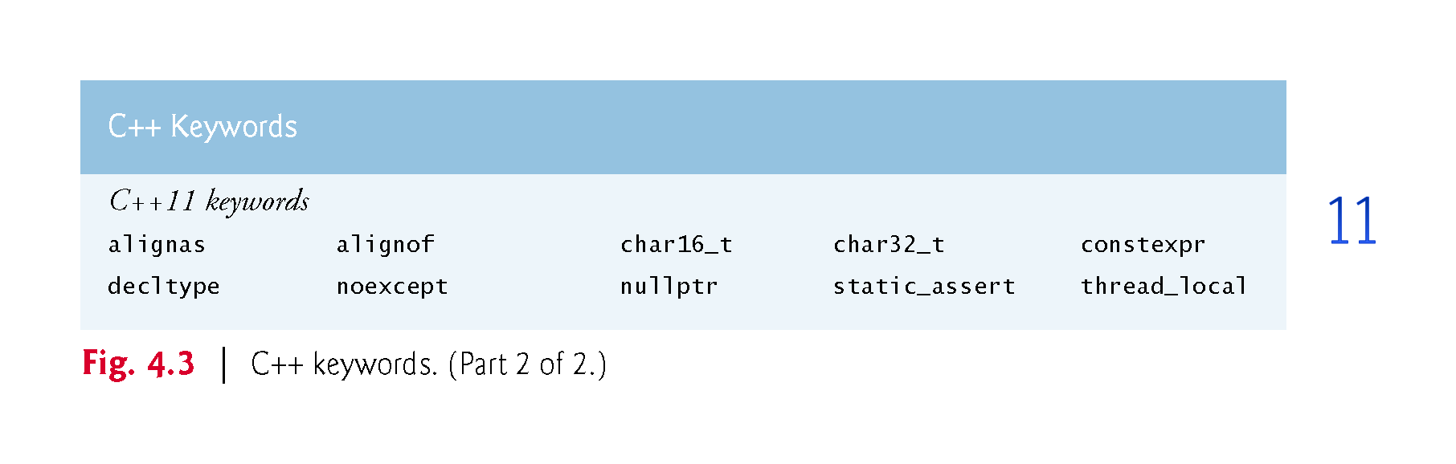

Slide 20
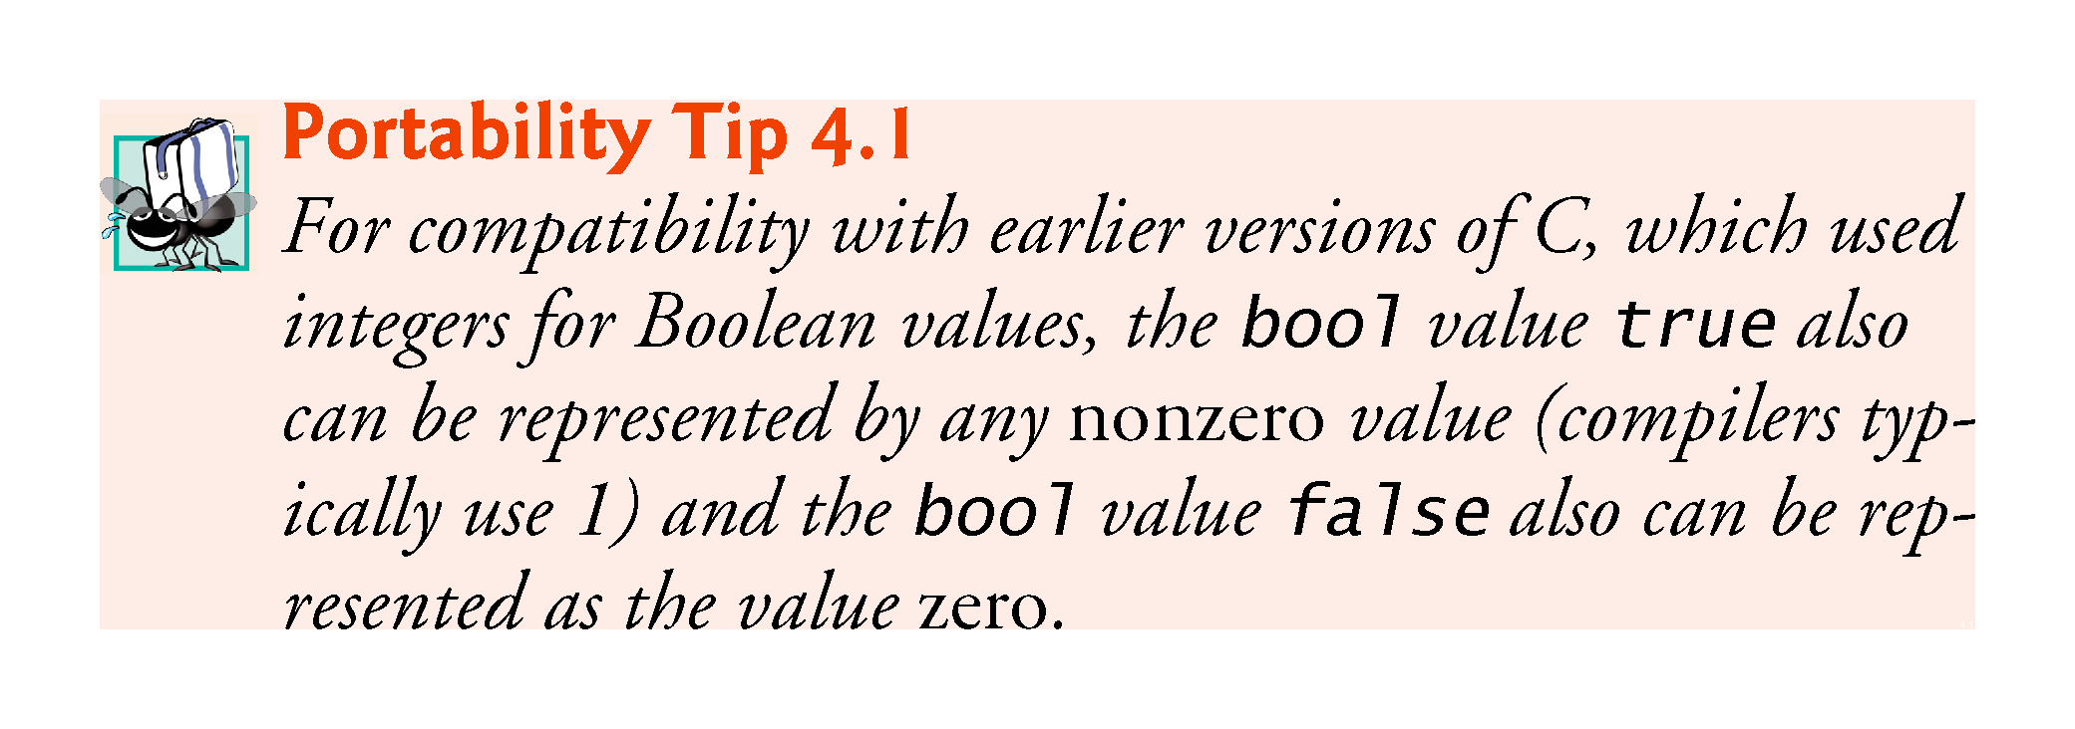

Slide 21
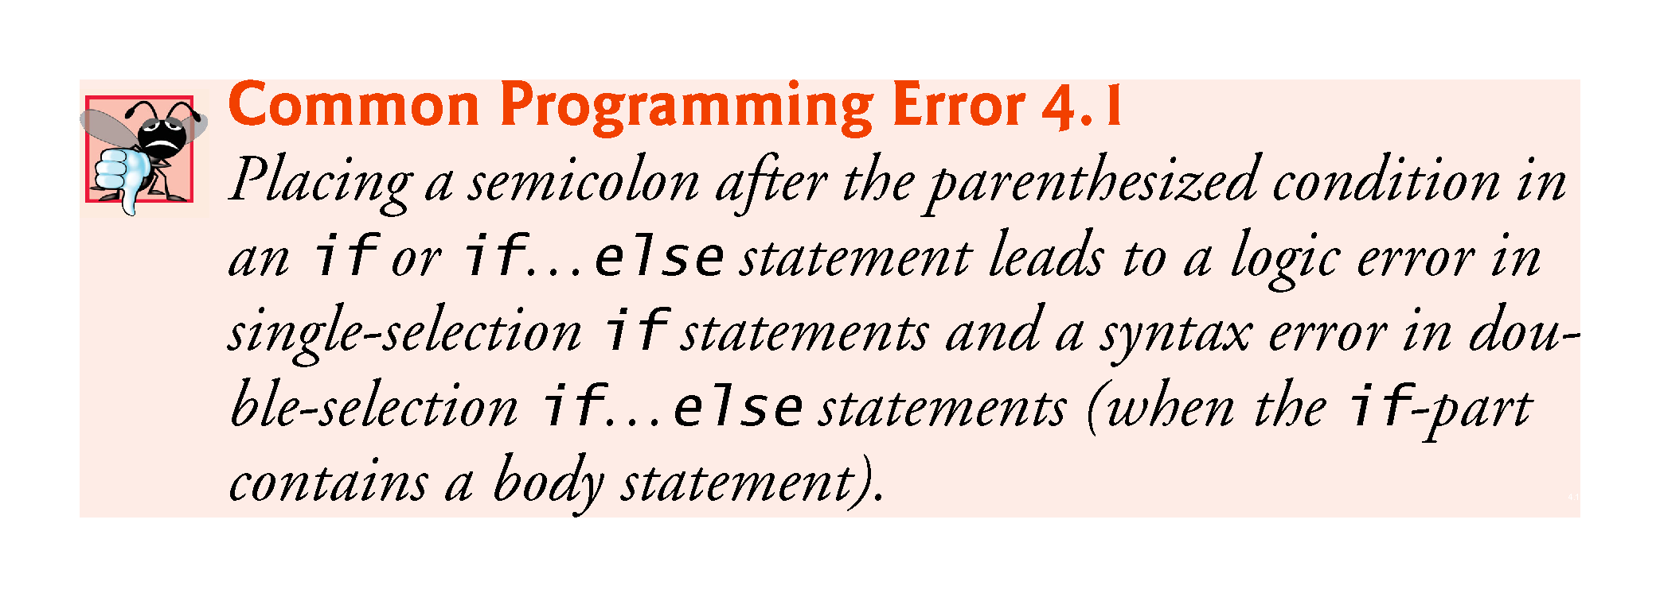

Slide 22
4.6.4 Conditional Operator (?:)
C++’s only ternary operator—it takes three operands.
Syntax:
( (condition) ? action if true : action if false )
It is just shorthand for:
if(condition)
action;
else
action;

Slide 23
4.8 while Iteration Statement
An iteration statement (also called a looping statement or a loop) allows you to specify that a program should repeat an action while some condition remains true.
While there are more items on my shopping list Purchase next item and cross it off my list
“There are more items on my shopping list” is true or false.
If true, “Purchase next item and cross it off my list” is performed.
Performed repeatedly while the condition remains true.
The statement contained in the While iteration statement constitutes the body of the While
Eventually, the condition will become false, the iteration will terminate, and the first pseudocode statement after the iteration statement will execute.

Slide 24
4.8 while Iteration Statement (cont.)
Consider a program segment that finds the first power of 3 larger than 100. When the following while iteration statement finishes executing, product contains the result:
int product = 3; while (product <= 100)
{ product = 3 * product; }

Slide 25
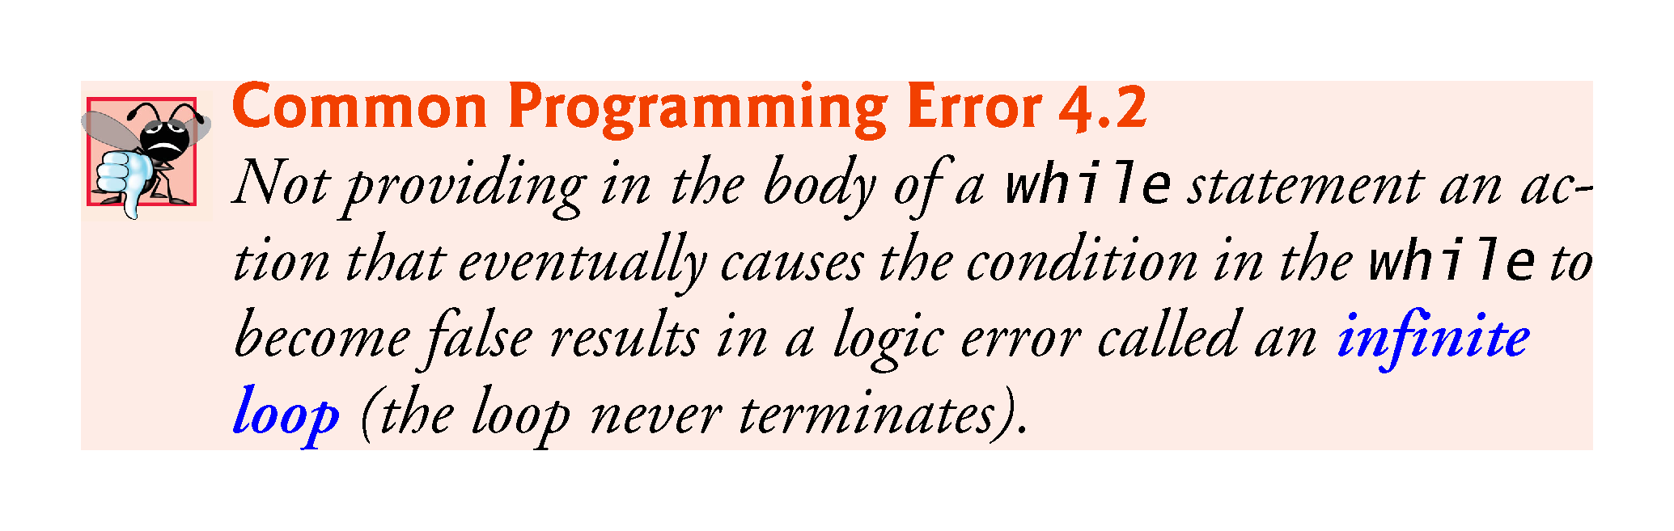

Slide 26
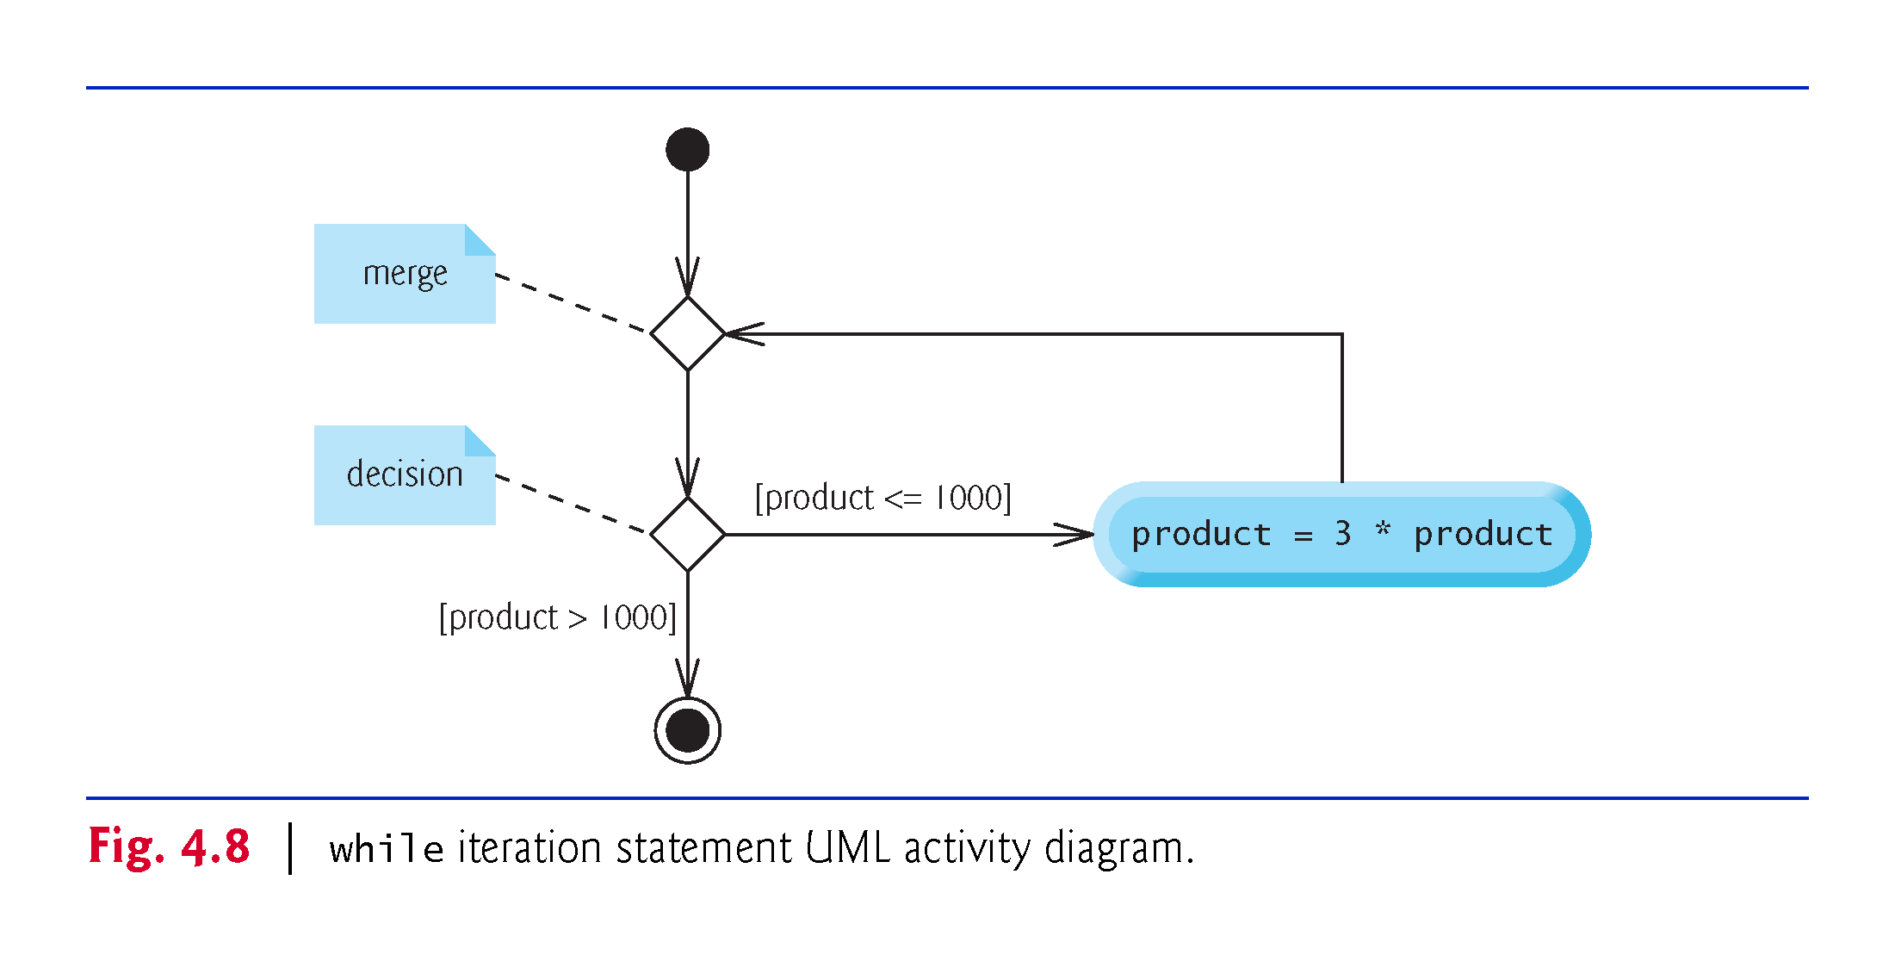

Slide 27
4.9 Formulating Algorithms: Counter-Controlled Iteration
Consider the following problem statement:
A class of ten students took a quiz. The grades (integers in the range 0-100) for this quiz are available to you. Determine the class average on the quiz.
The class average is equal to the sum of the grades divided by the number of students.
The algorithm for solving this problem on a computer must input each grade, keep track of the total of all grades entered, perform the averaging calculation and print the result.

Slide 28
4.9.1 Pseudocode Algorithm with Counter Controlled Iteration
To start, use a counter-controlled iteration to input the grades one at a time. Assume 10 grades.
This technique uses a variable called a counter (or control variable).
That is:
Define some variable count, initialized to 0;
While(count < 10)
{
cin << grade;
add grade to total, etc
count = count + 1;
}

Slide 29
4.9.2 Local variables
A variable declared in a function body is a local variable and can be used only from the line of its declaration to the closing right brace of the block in which the variable is declared.
A local variable’s declaration must appear before the variable is used; otherwise, a compilation error occurs.

Slide 30
4.9.3 Arithmetic Overflow
In Fig. 4.10, line 16
total = total + grade; // add grade to total
added each grade entered by the user to the total.
Even this simple statement has a potential problem—adding the integers could result in a value that’s too large to store in an int variable.
This is known as arithmetic overflow and causes undefined behavior, which can lead to security problems or unintended results
http://en.wikipedia.org/wiki/Integer_overflow #Security_ramifications

Slide 31
4.9.4 Input Validation
To ensure that inputs are valid, industrial-strength programs must test for all possible erroneous cases.
A program that inputs grades should validate the grades by using range checking to ensure that they’re values from 0 to 100.
You can then ask the user to reenter any value that’s out of range.
If a program requires inputs from a specific set of values (e.g., nonsequential product codes), you can ensure that each input matches a value in the set.

Slide 32
4.10.3 Implementing Sentinel-Controlled Iteration
An averaging calculation is likely to produce a number with a decimal point—a real number or floating-point number (e.g., 7.33, 0.0975 or 1000.12345).
Type int cannot represent such a number.
C++ provides several data types for storing floating-point numbers in memory, including float and double.
Compared to float variables, double variables can typically store numbers with larger magnitude and finer detail
more digits to the right of the decimal point—also known as the number’s precision.
Cast operator can be used to force the averaging calculation to produce a floating-point numeric result.

Slide 33
4.10.4 Converting Between Fundamental Types Explicitly and Implicitly
The variable average is declared to be of type double to capture the fractional result of our calculation.
total and gradeCounter are both integer variables.
Recall that dividing two integers results in integer division, in which any fractional part of the calculation is lost (i.e., truncated).
In the following statement the division occurs first—the result’s fractional part is lost before it’s assigned to average:
double average{total / gradeCounter};

Slide 34
4.10.4 Converting Between Fundamental Types Explicitly and Implicitly
To perform a floating-point calculation with integers, create temporary floating-point values.
static_cast operator accomplishes this task.
The cast operator static_cast<double>(total) creates a temporary floating-point copy of its operand in parentheses.
Known as explicit conversion.
The value stored in total is still an integer.

Slide 35
4.10.4 Converting Between Fundamental Types Explicitly and Implicitly
The calculation now consists of a floating-point value divided by the integer gradeCounter.
The compiler knows how to evaluate only expressions in which the operand types of are identical.
Compiler performs promotion (also called implicit conversion) on selected operands.
In an expression containing values of data types int and double, C++ promotes int operands to double values.
Cast operators are available for use with every data type and with class types as well.

Slide 36
4.10.5 Formatting Floating-Point Numbers
The call to setprecision (with an argument of 2) indicates that double values should be printed with two digits of precision to the right of the decimal point (e.g., 92.37).
Parameterized stream manipulator (argument in parentheses).
Programs that use these must include the header <iomanip>.
endl is a nonparameterized stream manipulator and does not require the <iomanip> header file.
If the precision is not specified, floating-point values are normally output with six digits of precision.

Slide 37
4.10.5 Formatting Floating-Point Numbers
Stream manipulator fixed indicates that floating-point values should be output in fixed-point format, as opposed to scientific notation.
Fixed-point formatting is used to force a floating-point number to display a specific number of digits.
Specifying fixed-point formatting also forces the decimal point and trailing zeros to print, even if the value is a whole number amount, such as 88.00.
Without the fixed-point formatting option, such a value prints in C++ as 88 without the trailing zeros and decimal point.

Slide 38
4.10.5 Formatting Floating-Point Numbers
When the stream manipulators fixed and setprecision are used in a program, the printed value is rounded to the number of decimal positions indicated by the value passed to setprecision (e.g., the value 2), although the value in memory re-mains unaltered.
It’s also possible to force a decimal point to appear by using stream manipulator showpoint.
If showpoint is specified without fixed, then trailing zeros will not print.
Both can be found in header <iostream>.

Slide 39
4.10.6 Unsigned Integers and User Input
Fig. 4.10 declared the variable gradeCounter as an unsigned int because it can assume only the values from 1 through 11 (11 terminates the loop), which are all non-negative values.
Could have also declared as unsigned int the variables grade, total and average. Grades are normally values from 0 to 100, so the total and average should each be greater than or equal to 0.
We declared those variables as ints because we can’t control what the user actually enters—the user could enter negative values.
Worse yet, the user could enter a value that’s not even a number.

Slide 40
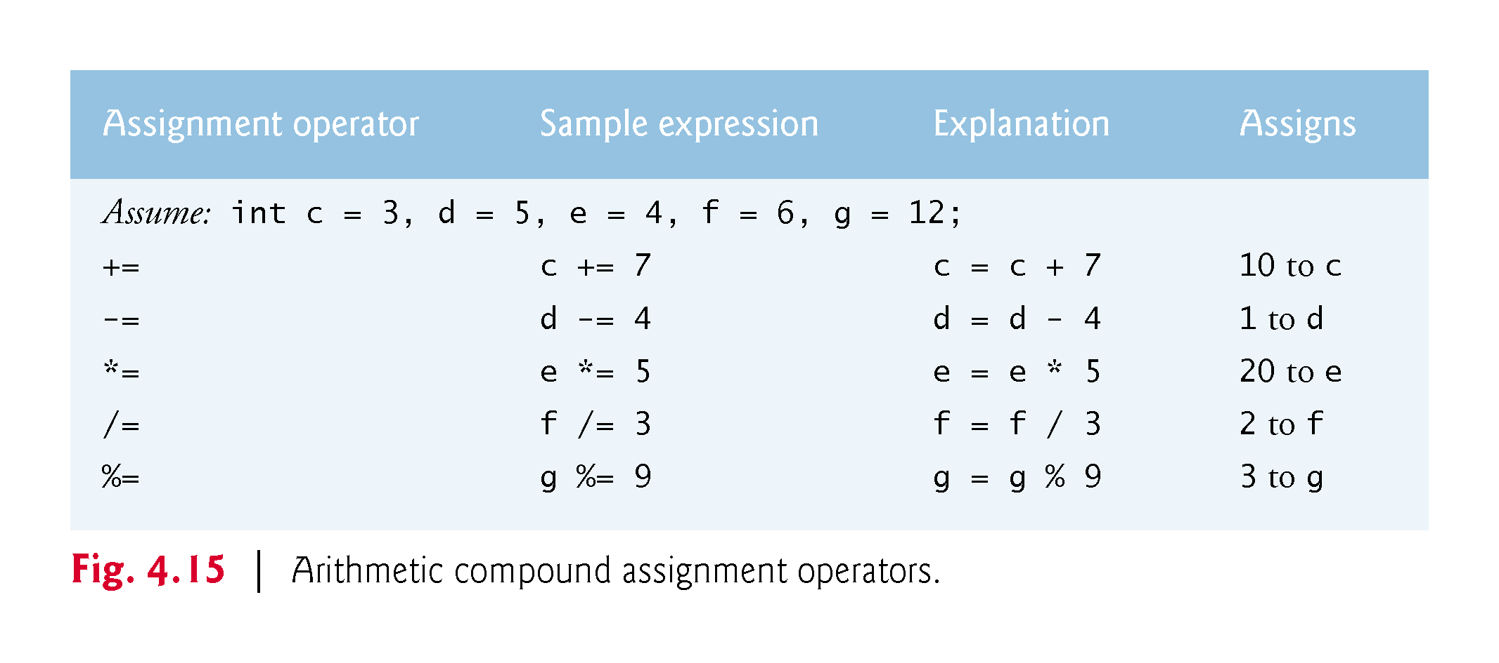

Slide 41
